Slide 1
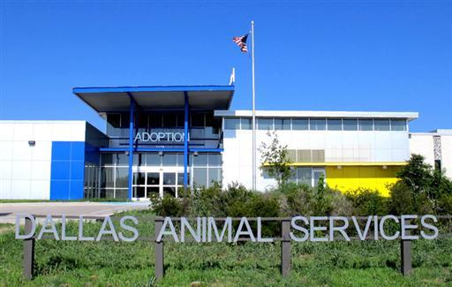
Predictive model the likely hood of Survival of Dog Visit TO Dallas Animal Shelter
Hamesh Alcendor
FTEC 6321

Slide 2
How safe are Dog visits to the Dallas Animal Shelter
Build a predictive model base on Dallas Animal shelter Dog visits for FY 2020 (OCT 2019 – SEPT 2020)
Reason Listed for this model
Dallas Animal Shelter can use model finding to dispel the negative consensus of treatment of Dogs by the shelter from general public( Public city funded institutions are marginalize for lack of care)
Ascertain additionally funding from Dallas City budget to foster community engagement projects for Animals(Dogs)
Animal Shelter would pin point major causes that exacerbate death of dogs during visit
Develop a system in place to help mitigate the likely hood of death

Slide 3
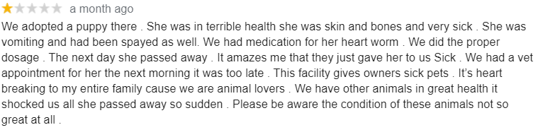
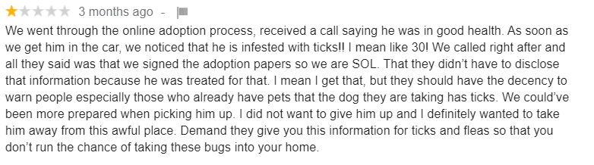
A few Negative reviews on Google (Finding of the model would help dispel)

Slide 4
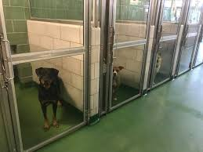
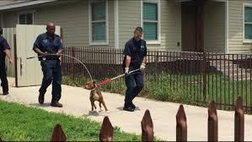
Dataset: Dallas Animal Shelter fy2019-2020
22,344 rows - Each Row represent 1 Dog visited FY2019-2020
35 columns – Each Column represent a feature (see below)
Column | Description
Animal Id | Genric Identification given upon entry
Animal Type | Animal Type
Animal Breed | Breed of Dog
Kennel Number | Kennel asigned to Dog
Kennel Status | Status of Kennel
Tag Type | Tag assigned
Activity Number | Activity
Activity Sequence | Movement of animal
Source Id | ID sourced to assign
Census Tract
Council District | Location originate from city
Intake Type | Causes the dog to be checked into the shelter
Intake Subtype | further examination
Intake Total | How many
Reason | Reason for Dog visit
Staff Id | Staff assigned to Dog
Intake Date | Date entered the shelter
Intake Time | Time entered the shelter
Due Out | Date expected out
Intake Condition | Condition entered the shelter
Hold Request | Reason forholding dog futher
Outcome Type | Type entered the shelter
Outcome Subtype | Subtype entered the shelter
Outcome Date | Date entered the shelter
Outcome Time | Time entered the shelter
Receipt Number | Receipt given
Impound Number | Impound number assigned
Service Request Number | Number entered the shelter
Outcome Condition | Condition entered the shelter
Chip Status | Chip assigned or not
Animal Origin | Origin entered the shelter
Additional Information | additional Information filed
Month | Month
Year | Year

Slide 5
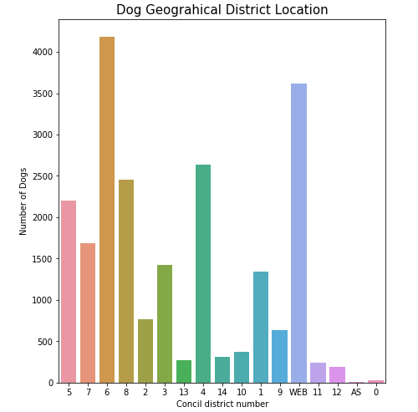
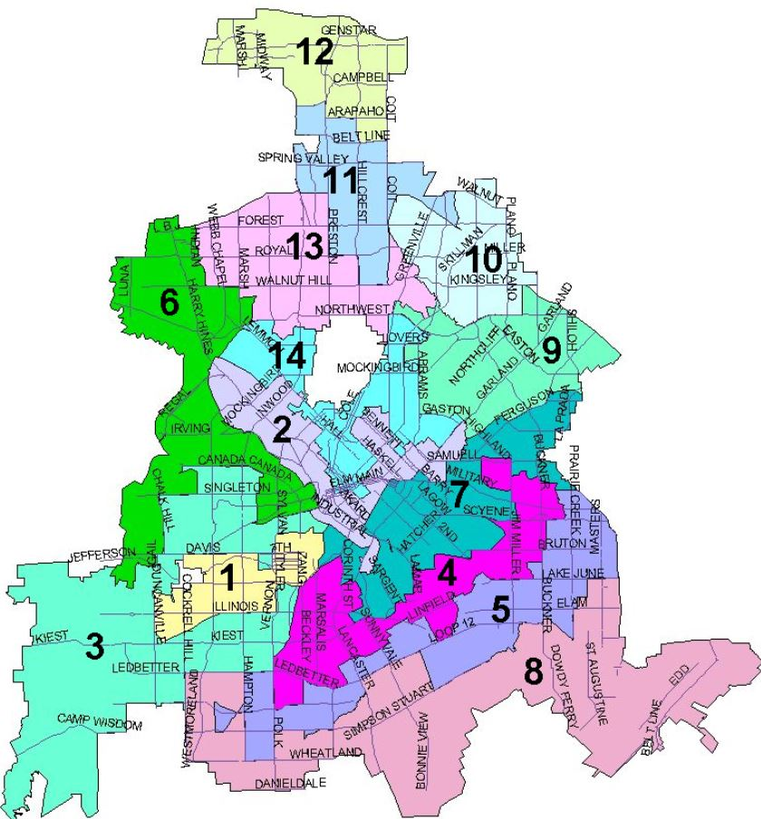
Exploratory Data Analysis
Dog Location by District Location
Dallas City Council Map

Slide 6
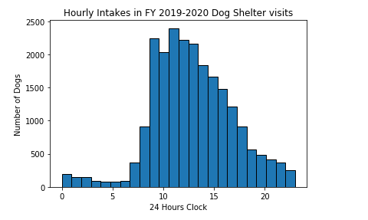
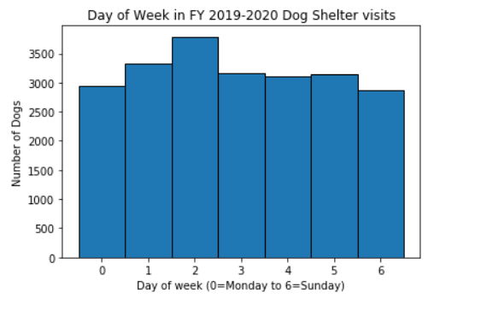
Exploratory Data Analysis
Hourly Intakes in FY 2019-2020 Dog Shelter visits
Day of Week in FY 2019-2020 Dog Shelter visits

Slide 7
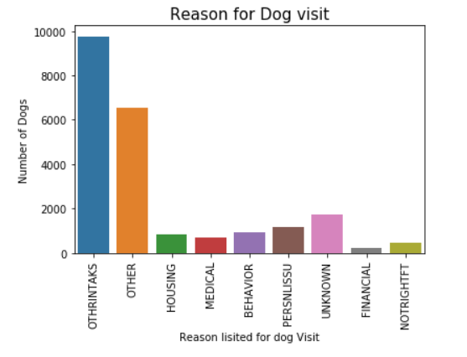
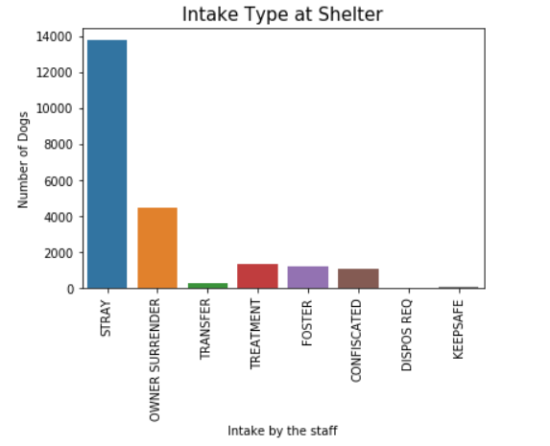
Exploratory Data Analysis
Reason listed for dog Visit
Intake Type at Shelter

Slide 8
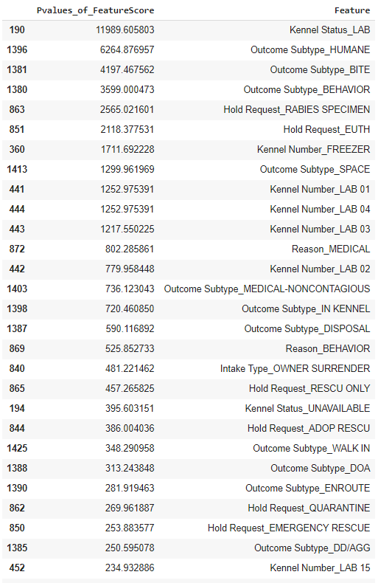
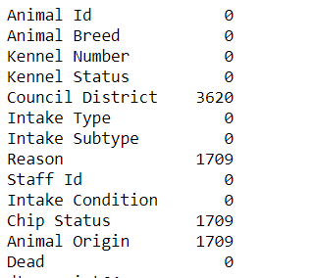
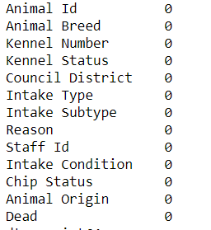
Data preparation & Feature
Missing Values
Fill in missing Na
Top 20 features Run with S-kbest feature

Slide 9
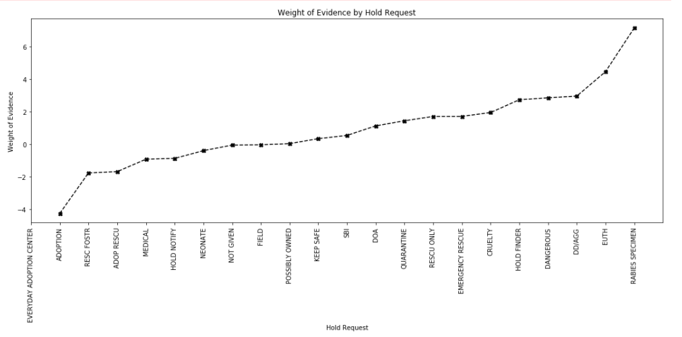
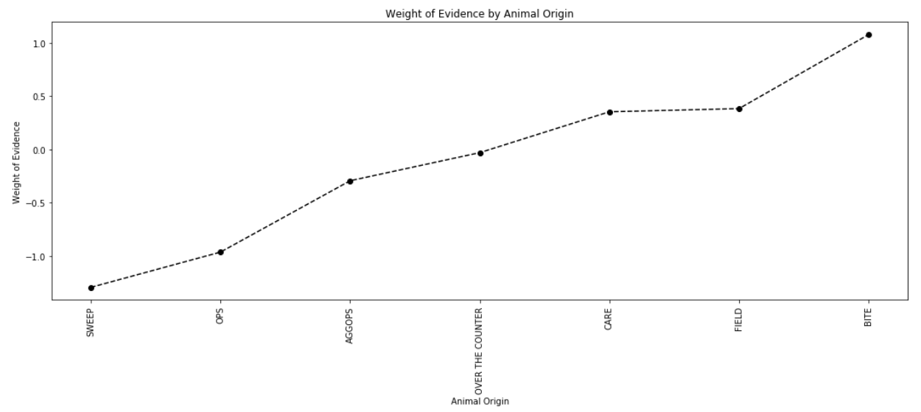
Feature Engineering (Measuring Weight of Evidence)

Slide 10
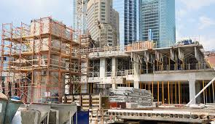
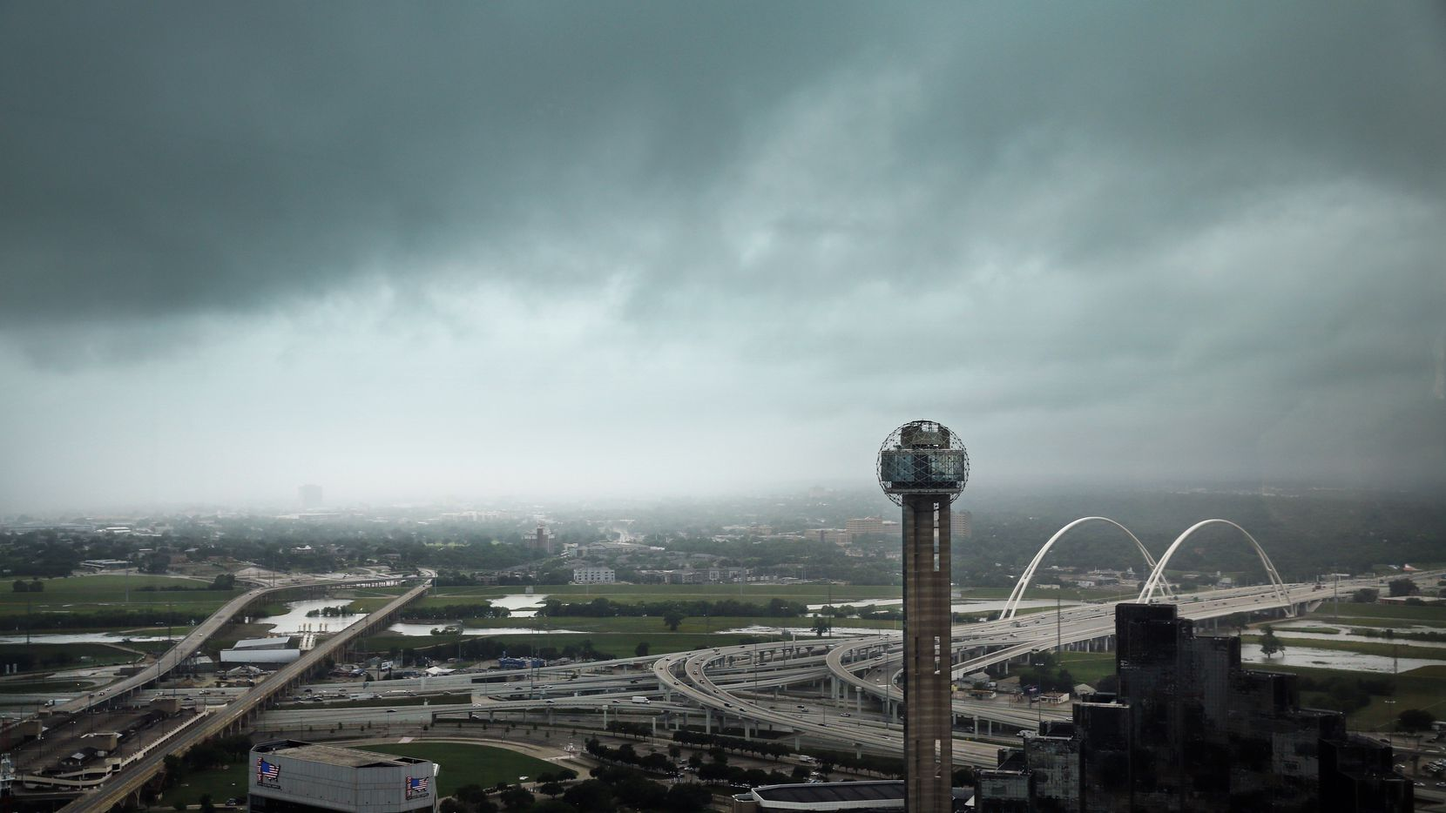
Feature Engineering
New Features Added
Weather Condition added for FY 2019-2020
Does the weather condition during transport of Dogs contribute to death
Dallas increase in commerce & construction causing air particles to be polluted
Weather Features added
Wind Gust -Sudden wind speed that last no longer than 20 seconds
Dew point - the atmospheric temperature below which water droplets begin to condense and dew can form
Wind - the flow of different gases within a large area
Precipitation - any kind of weather condition where something's falling from the sky
Temperature - measurement of how hot or cold

Slide 11
Modeling Setup
Machine Learning Classifiers used in this project:
Logistic regression
XG-Boosting
Gradient Boosting
Model | AUC Score | Hyperparameters
Logistic regression | 0.99866 | solver='lbfgs',max_iter=800,random_state=50
GradientBoosting | 0.99843 | max_depth=4,learning_rate=0.03,n_estimators=500,random_state=50
XGBOOST | 0.99776 | max_depth=4,learning_rate=0.03,n_estimators=500,random_state=50

Slide 12
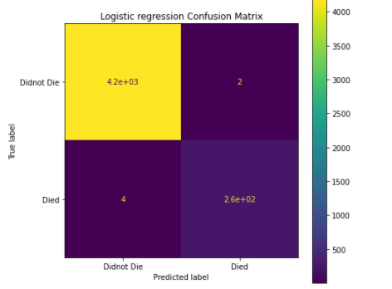
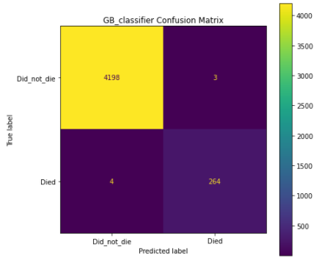
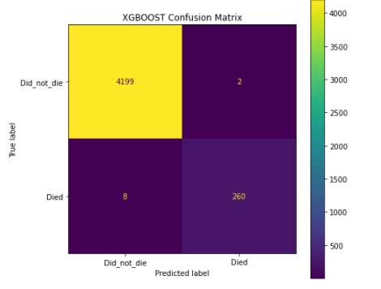
Comparison of Model’s Confusion Matrix

Slide 13
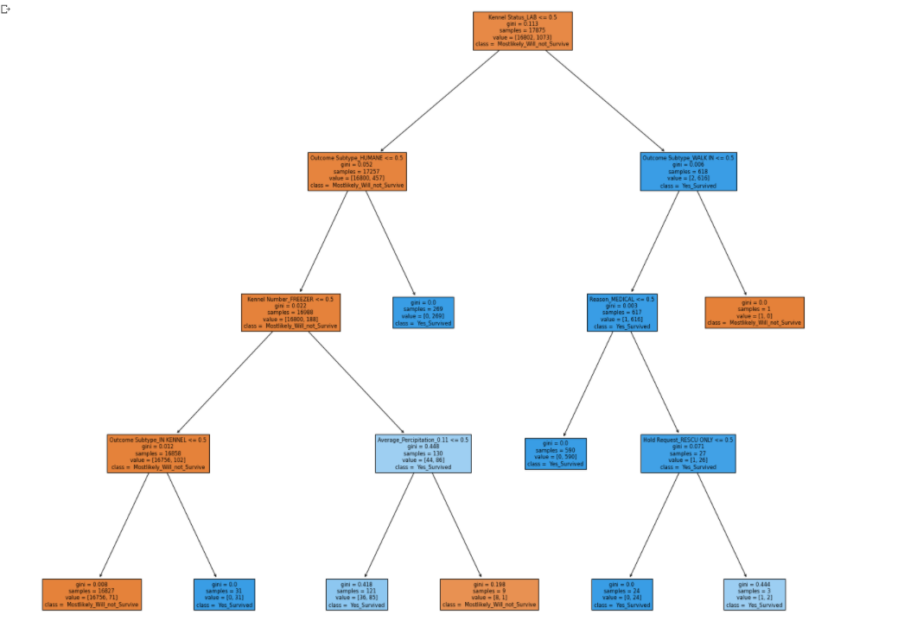
Decision tree

Slide 14
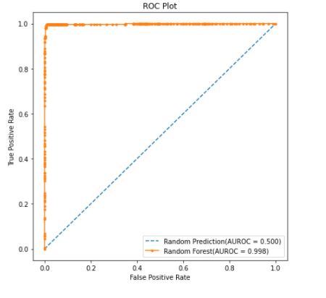
ROC curve (receiver operating characteristic curve)

Slide 15
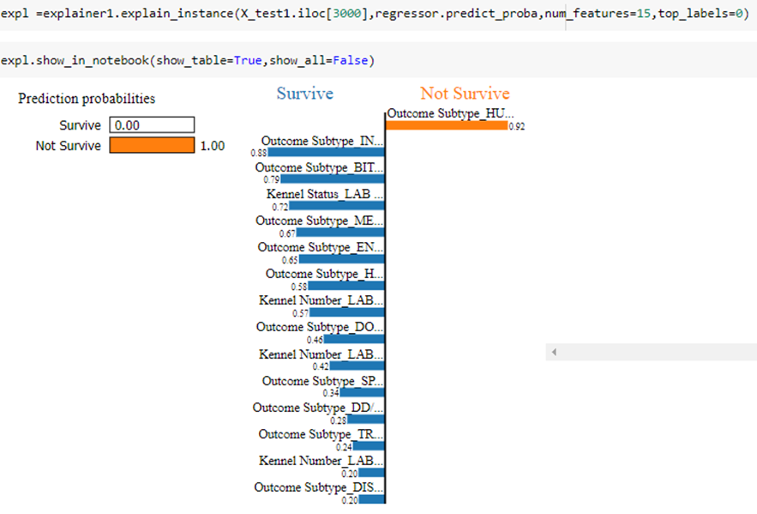
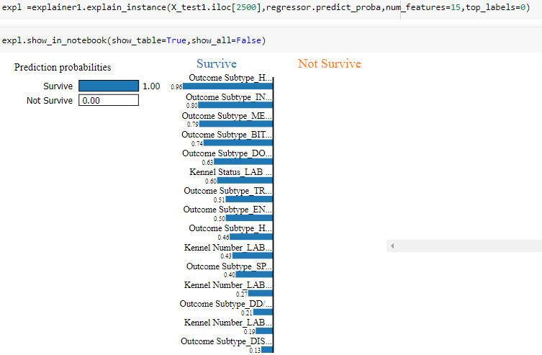
Testing Random Row Number of test set
Dog Number 3,000 Test set
Dog Number row 2,500 Test Set

Slide 16
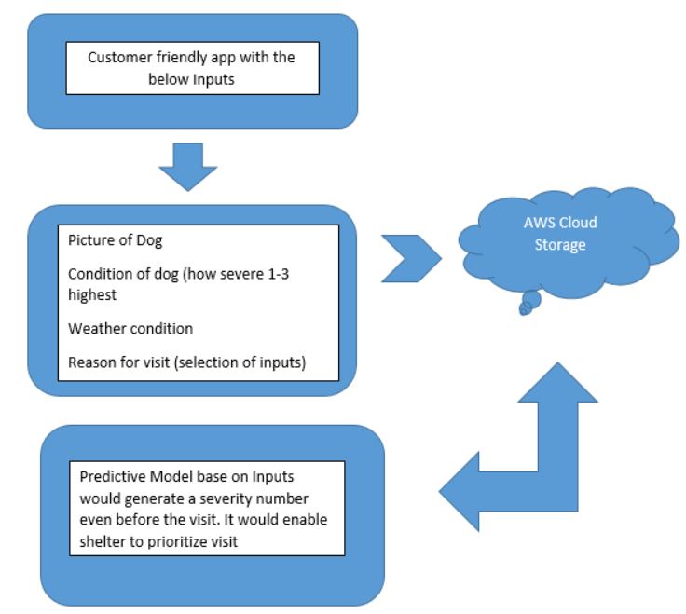
Conclusion
Dog are likely to survive a visit to the Dallas animal shelter ,However I recommend creating a user friendly app for field officers & customers alike to utilize before their visit . The app will generate a severity number to the staff at the shelter before the visit. It would enable shelter staff to prioritize visit to increase likely hood of survival.

Slide 17
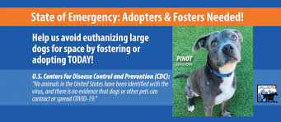
Questions

